Slide 1

Web Service Security
CIS 360 – Prof. C. R. Johnson
University of Wisconsin – Stevens Point

Slide 2
What is web services ?
A set of standards to support interoperability among applications developed in different languages and running on different platforms or operating systems.
Application ←→Application
supports easy integration, reusability, and dynamic e-business.
Web service is related to various technologies like SOAP, UDDL, and WSDL.
Notes:
Today, Web Services is widely adopted in e-business. Web Service is a huge revolution in e-business, it changes the concept of application interactions from human-centric where client plays the main roles in interaction to application-centric which means application to application interaction.

Slide 3
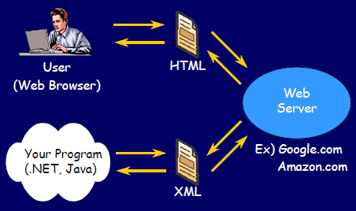
What is web services ?

Slide 4
What is web services ?
SOAP message : transfer information
UDDI : discovering services
WSDL : describing the services.
WS depends on SOAP to transmitting messages between components, and use it as a standard way to exchange XML data.
SOAP protocol specification does not provide any security.
The major concern when Web Service is used to transfer sensitive information is security.
Notes:
- SOAP(Simple Object Access Protocol)
SOAP is the most significant Web Services technologies. SOAP is a standard that exchanges message in XML format[3].Although SOAP protocol is used to exchange the messages in Web Services but this protocol does not describe the message format which is solved by defining the WSDL[3].
- UDDI (Universal Description, Discovery and
Integration)
The process where services requestor can discover the services provider and the description of the web services is called services discovery.
UDDI is registry standard, services requester will use it to search about services[4]. It stored data and metadata about Web Services, these information such that services location and how to invoke registered Web Services are contained in UDDI
- WSDL (Web Services Description Language)
WSDL is XML-based format. It is a document that describes Web Services. WSDL is a guidebook for Web Services and contains information about what a service does and how user can access this service[4]. which is an XML-based, machine-generated, and machine-readable document that presents how to access to a Web Service.
- XML
XML provides many great advantages for transmitting data across the Internet.XML is a structure document. It is simple, independent, and extensible. These characteristics make XML adopted in many applications

Slide 5
Why WS-Security?
Most of Web Services based on SSL(Secure Socket Layer) / TLS (Transport Layer Security) to secure SOAP message.
Using SSL / TLS does not provide enough security, there are many limitations of SSL:
SSL / TLS ensure only the point-to-point security.
SSL / TLS encrypts the whole message.
SSL / TLS does not sign the data.
SSL / TLS is inflexible routing because it is just Point-to- Point
Notes:
document needs to be sent as a whole, and different parts might have different security requirements.
Transmission system can’t be expected to respect these differences
Merchant needs to know customer’s name and address, but not credit card number

Slide 6
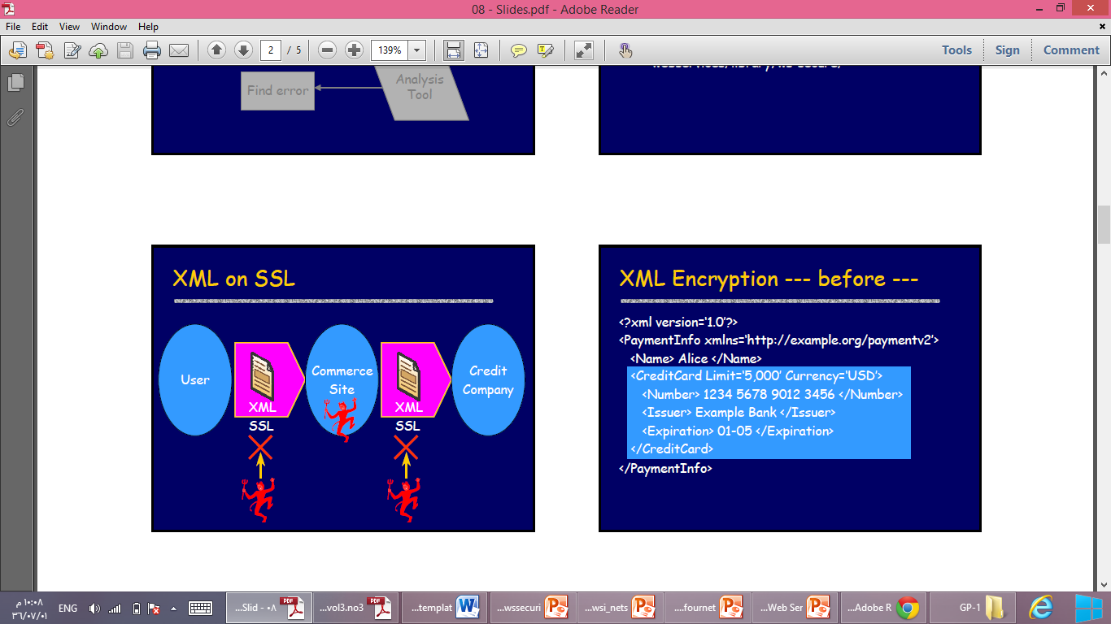
Why WS-Security?
Notes:
Most of Web Services based on SSL(Secure Socket Layer) to secure SOAP message. Actually using SSL does not provide enough security, there are many limitations of SSL:
1) SSL ensure only the point-to-point security.
2) SSL encrypts the whole message.
3) SSL does not sign the data.
4) SSL is inflexible routing because it is just Point-to- Point
based on only SSL(Secure Socket Layer) cannot provide enough security because SSL is unable to achieve end-to-end security

Slide 7
Complexity of WS-Security
An XML document might contain data describing an entire interaction; however each portion should only be viewed by a particular audience.
Should tags be encrypted?
If yes, searching with XPath might be inhibited and security might be compromised (since the plaintext associated with encrypted data can be guessed)
Notes:
Personal details of a medical record should not be available to a researcher, doctor should be able to see medical details but not credit card data, some medical details should not be available to administrator.
Different parts of document might have to be signed by different participants
The subsets might intersect, so multiple encryption might be required for certain portions
------

Slide 8
Web Services security standard
XML Digital Signature
XML Encryption
The XML Key Management Specification (XKMS)

Slide 9
XML Digital Signature
XML signature is defined by W3C .
XML signature determines the representation of signed data in XML.
The practical benefit of XML Signature is partial signature which allows signing part of XML document by using specific tags.
The XML Digital Signature can solve security problem such as spoofing and repudiation.

Slide 10
XML Digital Signature
XML signature is a common method for ensuring the XML data integrity, authentication, and non-repudiation.
An entire document or individual elements can be signed. Allows for the fact that:
Different individuals might be responsible for different parts of the message.
Some parts of the message should not be changed, others are changeable

Slide 11
XML Digital Signature
The signature is computed in two stages:
A digest, using dig_fn1 , is computed of the data and encapsulated in a <SignedInfo> element
A digest, using dig_fn2 , is computed of the <SignedInfo> element and signed using the private key of the sender.

Slide 12
XML Digital Signature (Structure)
<Signature xmlns=“ …XML Signature namespace…”>
<SignedInfo>
<CanonicalizationMethod Algorithm=“ … “/>
<SignatureMethod Algorithm=“…hash/public key encryption …” />
<Reference URI=“…locate item to be signed …” />
<DigestMethod Algorithm=“ …hash algorithm for item…/>
<DigestValue>xyT14Rst…</DigestValue>
</Reference>
</SignedInfo>
<SignatureValue>xYzu2fR….</SignatureValue>
</Signature>
digest of
data
signature of entire
<SignedInfo> element

Slide 13
XML Digital Signature ( benefit)
XML Signature is more flexible than other forms of digital signatures such as Pretty Good Privacy and Cryptographic Message Syntax, because it does not operate on binary data, but on the XML Infoset :
allowing to work on subsets of the data.
having various ways to bind the signature and signed information, and perform transformations.

Slide 14
XML Encryption
The confidentiality of message is provided by using XML encryption.
XML Encryption supports the selective as XML Signature which means the support of the encryption of portion of data.
XML encryption specification distinguishes between encryption information and encrypted data and determines the encryption key information and encryption algorithm

Slide 15
XML Encryption
Example:
<payment xmlns=“…”>
<name> John Doe </name>
<creditCard type=“visa” limit=“5000” \>
<number> 1234 5678 9012 3456 </number>
<issuer> Bank of XY </issuer>
<expiration> 04/09 </expiration>
</creditCard>
</payment>

Slide 16
XML Encryption
Example: encrypt the credit card element (including tags)
Encrypted element replaces element
encrypting
an element
<payment xmlns=“…”>
<name> John Doe </name>
<EncryptedData Type=“http://www.w3.org/2001/04/xmlenc#Element
xmlns=“…XML encryption namespace…”>
<EncryptionMethod Algorithm=“…” />
<KeyInfo xmlns=“…”>
<KeyName> keyABC </KeyName>
</KeyInfo>
<CipherData>
<CipherValue> AB12VY54321X ….. </CipherValue>
</CipherData>
</EncryptedData>
</payment>
encryption
algorithm
identify key to
receiver
encrypted
data

Slide 17
XML Encryption – Some Alternatives
Symmetrically encrypt data, assume the receiver knows the key and include key name (previous example)
Symmetrically encrypt data, include encrypted key in message (encrypted with public key of receiver) (next example)

Slide 18
XML Encryption and SOAP
Store encryption key in header, encrypted data is body, an element w/i body, or an attachment.
The result of the encryption must be a valid SOAP envelope
Can’t encrypt <s:Envelope>, <s:Header> or <s:Body> elements; only their descendants

Slide 19
XML Encryption (2)
WS-Security used to attach XML Encryption
Encrypted key is stored in header
wsse – prefix for WS-Security
xenc – prefix for XML Encryption
ds – prefix for KeyInfo element
<s:Header>
<wsse:Security>
<xenc:EncryptedKey >
<xenc:EncryptionMethod
Algorithm=“…pub. key algo. to encrypt symmetric key…”/>
<ds:KeyInfo> <ds:KeyName> Bill </ds:KeyName>
</ds:KeyInfo>
<xenc:CipherData>
<xenc:CipherValue>abcd456…</xenc:CipherValue>
</xenc:CipherData>
<xenc:ReferenceList>
<xenc:DataReference URI=“#EncrData” />
</xenc:ReferenceList>
</xenc:EncryptedKey>
</wsse:Security>
</s:Header>
Bill’s publ. key encrypts sym. key
optional, receiver
may know it
encrypted symmetric key
list of data items encrypted with
symmetric key
Notes:
WS-Security, sec 5, XML Encryption, sec 2.2.2

Slide 20
XML Encryption (2)
Encrypted data is stored in body
identifies data
<s:Body>
<xenc:EncryptedData Id=“EncrData”
Type=“http://www.w3.org/2001/04/xmlenc#Element />
<xenc:EncryptionMethod
Algorithm=“…symmetric algo. to encrypt data…” />
<xenc:CipherData>
<xenc:CipherValue>A341BB…</xenc:CipherValue>
</xenc:CipherData>
</xenc:EncryptedData>
</s:Body>
data encrypted
with symmetric key

Slide 21
XML Key Management Specification (XKMS)
Determine a protocol that register, distribute, and process public key.
The XKMS performs two things:
Register public and this is done by XML Key Registration Service Specification (X-KRSS).
Rely on key to retrieve the information and this is supported by XML Key Information Service Specification (X-KISS).

Slide 22
Security Assertion Markup Language (SAML)
SAML is XML language provides a solution for making security statement about user identity.
The basic concept of SAML is : assertion which is statements or claims about user.
The need to SAML is : to provide portable trust which means a user whose already identified and verified in such domain has a right to use services in another domain (Single Sign On).

Slide 23
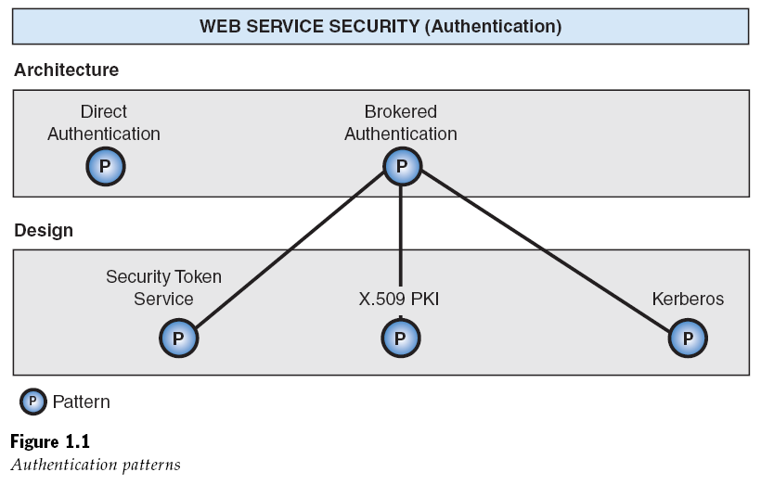
Authentication Patterns

Slide 24
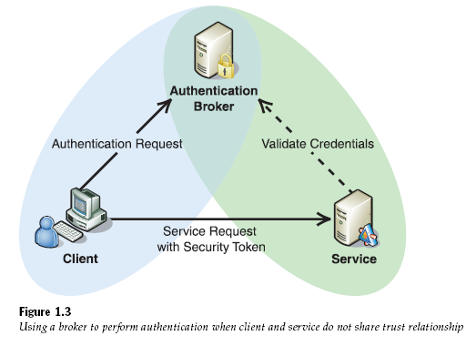
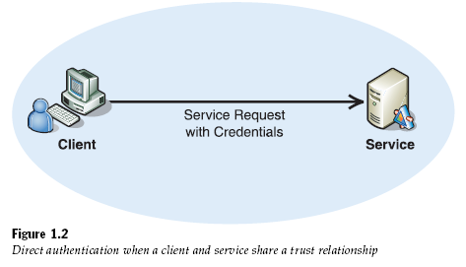
Direct Authentication vs. Brokered Authentication

Slide 25
Important Concepts
Authentication
the process of identifying an individual using the credentials of that individual
Authorization
the process of determining whether an authenticated client is allowed to access a resource or perform a task within a specific security domain
Credentials
A set of claims used to prove the identity of a client
Identification
represents the use of an identifier that allows a system to recognize a particular subject and distinguish it from other users of the system

Slide 26
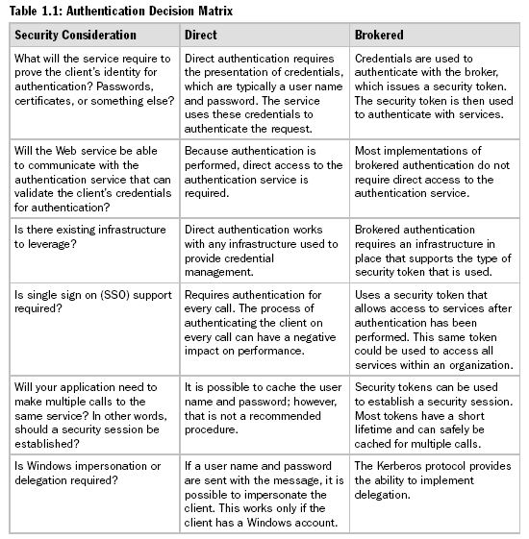

Slide 27
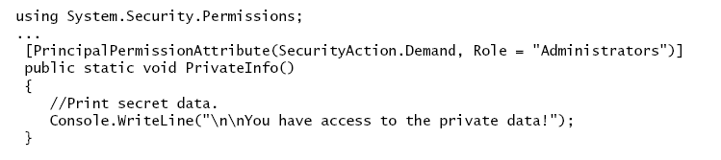
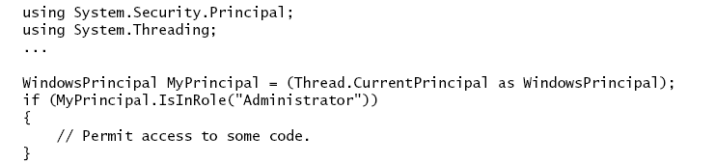
Authorization Methods
Declarative role-based authorization can be added to application code at design time. Required access for a particular method or class is declared as an attribute in code
Imperative role-based authorization is written into the application code to make authorization decisions at run time.

Slide 28
Resource-based Authorization
Resource-based authorization is performed declaratively on a resource, depending on the type of the resource and the mechanism used to perform authorization
Access Control List ( ACL )
URL Authorization

Slide 29
Direct Authentication
A client needs to access a Web service. The Web service requires the client to present credentials for authentication so that additional controls such as authorization and auditing can be implemented.
Problem
How does the Web service verify credentials that are presented by the client?
Conditions and reasons that force using this solution
The credentials that the client presents to the Web service are based on shared secrets, such as passwords
The Web service can validate credentials from the client against an identity store.
The Web service is relatively simple, and does not require support for capabilities such as single-sign on (SSO) or support for non-repudiation.
The client and the Web service trust one another to manage credentials securely.

Slide 30
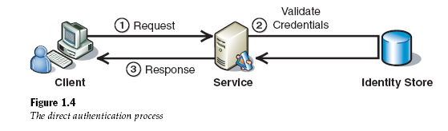
Solution
Use direct authentication where the Web service acts as an authentication service to validate credentials from the client
Direct authentication involves the following participants:
Client
Service
Identity store

Slide 31
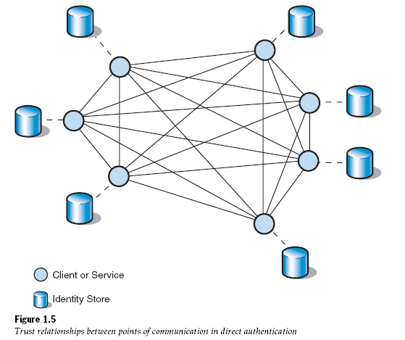
Benefits
It represents an uncomplicated model for authenticating clients without the need for an authentication broker
If the shared secret between a requester and service is compromised, only the relationship between those two parties is compromised and not the entire model.

Slide 32
Liabilities cont.
Direct authentication does not provide single sign on capabilities.
The decentralized nature of direct authentication requires that the trust relationship be managed between each point in the communication.
If a client calls a Web service frequently, the use of direct authentication can increase latency, because the Web service typically authenticates against a remote identity store.
Data ownership and synchronization issues can occur if each of several services has its own identity store to authenticate the same client. This is because the client’s credentials may need to be duplicated across multiple identity stores.

Slide 33
Brokered Authentication
Context
A client needs to access a Web service. The Web service requires the application to present credentials for authentication so that additional controls such as authorization and auditing can be implemented.
Problem
How does the Web service verify the credentials that are presented by the client?

Slide 34
Solution
Use brokered authentication where the Web service validates the credentials presented by the client, without the need for a direct relationship between the two parties. An authentication broker that both parties trust independently issues a security token to the client. The client can then present credentials, including the security token, to the Web service.
Brokered authentication involves the following participants:
Client
Service
Authentication broker
Identity store

Slide 35
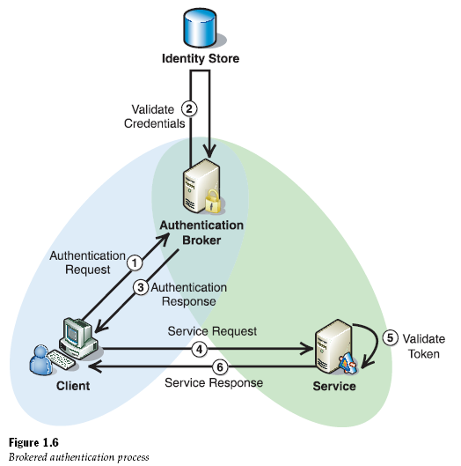

Slide 36
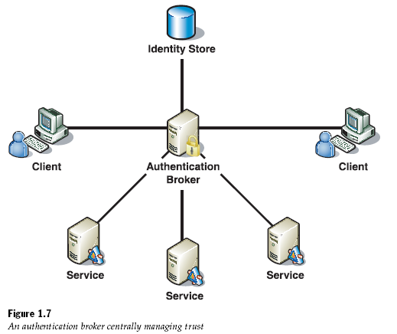
Benefits
The authentication broker manages trust centrally. This eliminate the need for each client and service to independently manage their own trust relationships.
Adding a new user is easier than direct authentication because its credentials is maintained in one central point.
Two parties do not require prior knowledge of one another.
Trust relationships can be established between different authentication brokers.

Slide 37
Liabilities
Single point of failure.
Any compromise of an authentication broker results in the integrity of the trust that is provided by the broker also being compromised.
Common types of authentication brokers
X.509 PKI
Kerberos protocol
Web Service Security Token Service ( STS )

Slide 38
Message Protection Patterns
Message protection can be divided into three main categories:
Data integrity
Data origin authentication
Data confidentiality

Slide 39
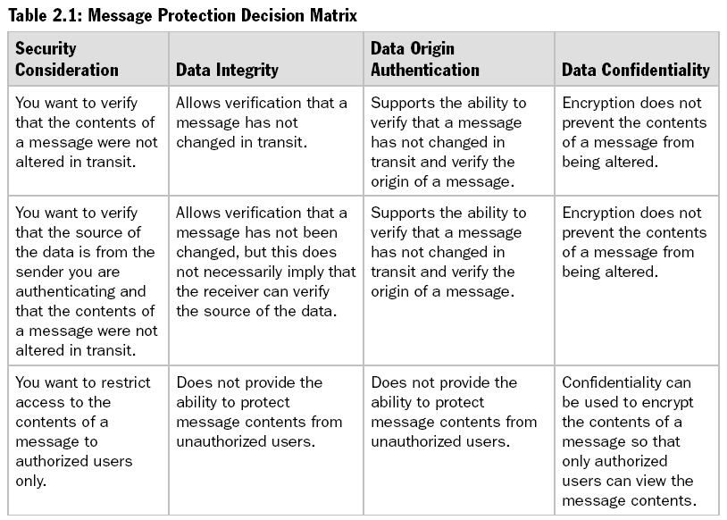

Slide 40
Data Confidentiality
Context
There is a risk that an attacker can gain access to sensitive data , either by eavesdropping on the network or accessing a repository.
Problem
How does you protect data within a message from being disclosed to unintended parties?

Slide 41
Data Confidentiality
Conditions and reasons that force using this solution
Disclosure of sensitive data can result in loss or damage , such as identity theft , lawsuits , loss of business , or regulatory fines.
Sensitive data may pass across the network.
Sensitive data may be persisted for short periods of time , such as in a message queue , or over longer periods of time in a database or file.
Solution
Use encryption to protect sensitive data that is contained in a message.

Slide 42
Participants
Direct authentication involves the following participants:
Sender
Recipient
You can apply data confidentiality in two steps:
Encryption the data.
Decryption the data.

Slide 43
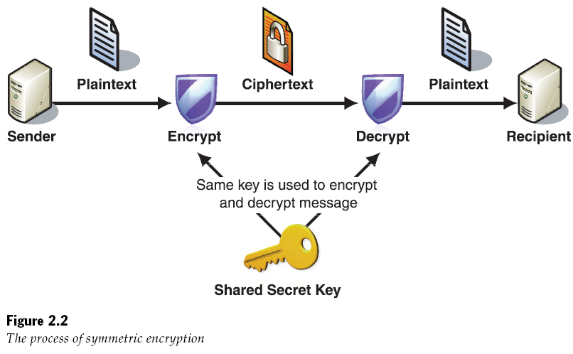
Symmetric Cryptography
Both the sender and recipient share a key to perform both encryption and decryption.

Slide 44
Symmetric Algorithms
Two Symmetric Algorithms:
Rijndael (AES)
Triple DES (3DES)
Symmetric cryptography is completely simple in nature because the secret key that is used for both encryption and decryption is shared between the sender and the recipient.
However , before communication can occur , the sender and the recipient must exchange a shared secret key.
In some cases (such as SSL) , asymmetric cryptography can be used to ensure that the initial key exchange occurs over a secure channel.

Slide 45
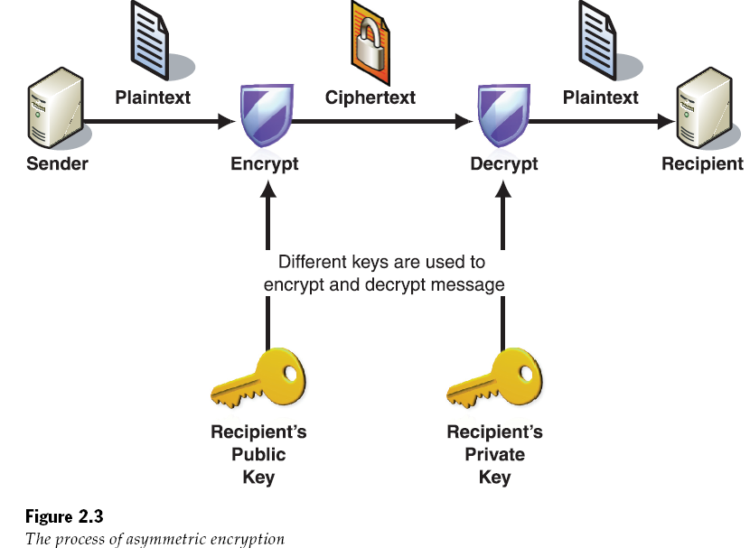
Asymmetric (public key) cryptography
The sender encrypts data with one key , and the recipient uses a different key to decrypt ciphertext.

Slide 46
Asymmetric Algorithms
The most common asymmetric algorithm is:
RSA
Asymmetric algorithms provide:
Encryption
Digital signature
Nonrepudiation
Key management process in symmetric algorithms
Asymmetric encryption requires more processing resources than symmetric encryption. For this reason it is usually used to asymmetrically encrypting the shared key in symmetric algorithms.

Slide 47
Data Origin Authentication
Context
There is a risk that an attacker may manipulate data , modify or even substitute it , to change the apparent source of the request message.
Problem
How do you prevent an attacker from manipulating messages in transit between a client and a web service?
Solution
Use data origin authentication, which enables the recipient to verify that messages have not been tampered with in transit (data integrity) and they originate from the expected sender (authenticity).

Slide 48
Symmetric Signature
A symmetric signature is created by using a shared secret to sign and verify the message. It is commonly known as a Message Authentication Code( MAC )
The most common type of MAC is a
Hashed Message Authentication Code( HMAC ) protocol that uses a shared secret and a hashing algorithm ( such as MD5 , SHA-1 , or SHA-256 ) to create the signature.

Slide 49
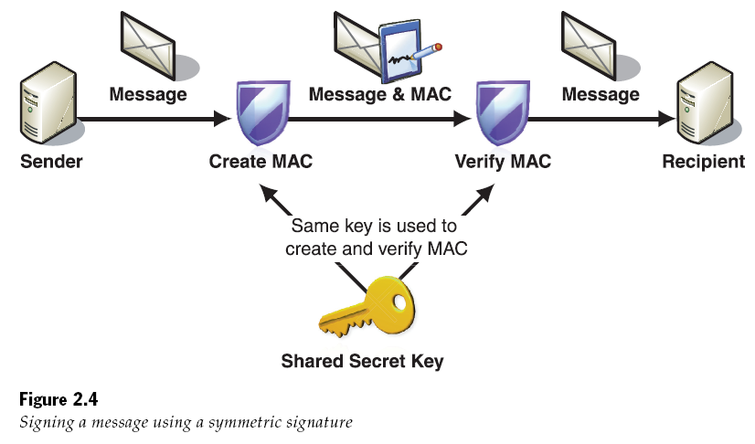

Slide 50
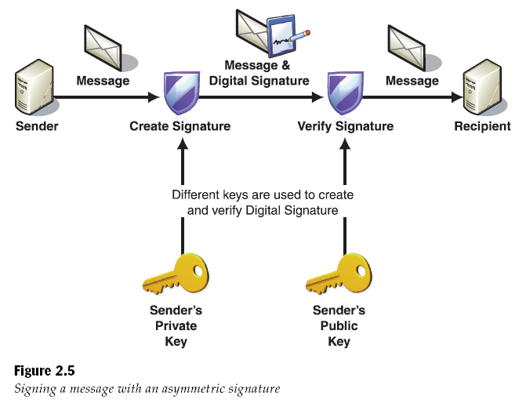

Slide 51
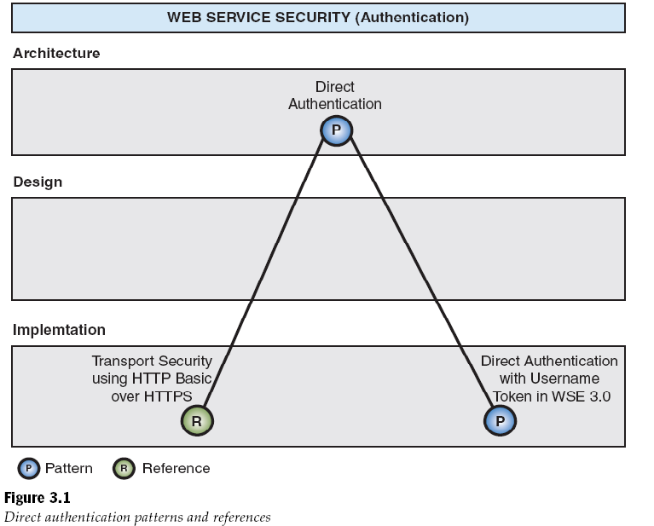

Slide 52
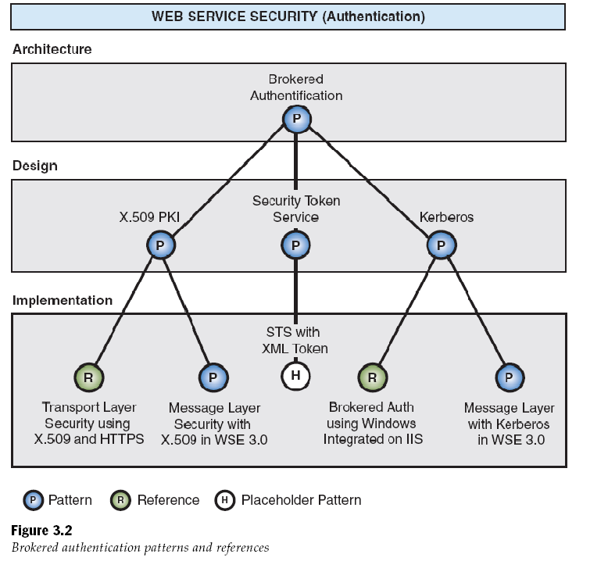

Slide 53
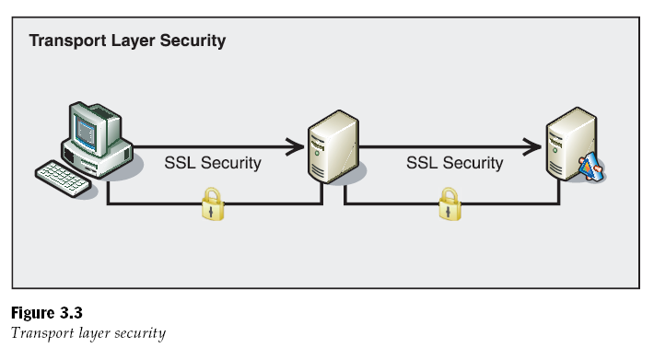
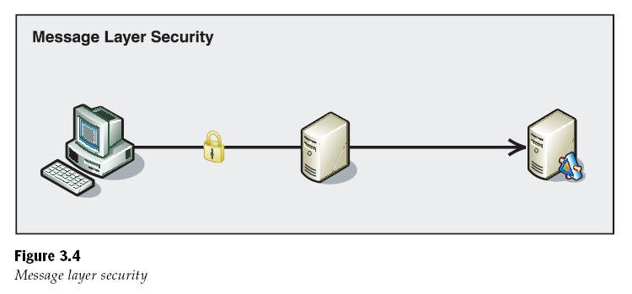
Transport Layer vs. Message Layer Security

Slide 54
Advantages of Message Layer Security over Transport Layer Security
Increase flexibility encrypt part of the message instead of the entire message
Support for auditing
Support for multiple protocols (SMTP, FTP, TCP)

Slide 55
Implementing message layer security with X.509 certificates
The service initializes and sends a message with X.509 certificate information
1. the client retrieves the service’s X.509 certificate.
2. the client retrieves its own certificate and private key.
3. the client attaches its X.509 certificate to a message.
4. the client signs the message using its private key.
5. the client encrypts the message using the services public key.
6. the client sends the message to the service.

Slide 56
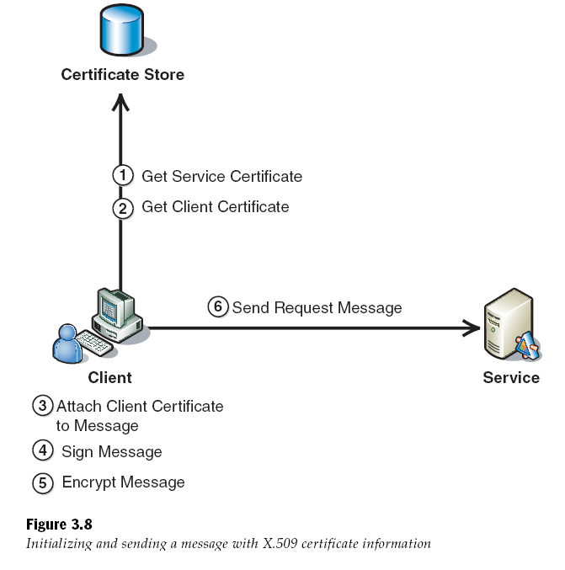

Slide 57
X.509 Certificate
The service authenticates a client using the X.509 certificate and signature
1. The service validates the client’s certificate.
2. The service verifies the certificate trust chain.
3. The service checks the certificate revocation status.
4. The service decrypts message.
5. The service verifies the signature.
6. The service initializes and sends a response to the client.

Slide 58
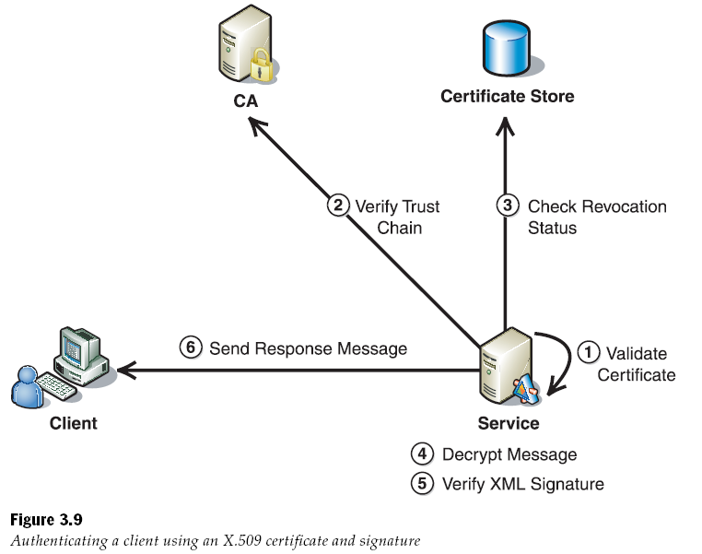

Slide 59
Implementing transport layer security using X.509 certificates and HTTPS
Process
Implement transport layer security using SSL.
Configure the web service virtual directory to use SSL and require client certificates.
Benefits
It provide brokered authentication, data confidentiality, and data origin authentication capabilities in one solution .
It uses SSL , which is a well established protocol that is easy to configure and implement on the windows platform.
Liabilities
Configure SSL between several points ,because it is a point to point security protocol, may cause unacceptable application response times.
All points in the communication must be sufficiently trusted to establish SSL.

